Slide 1
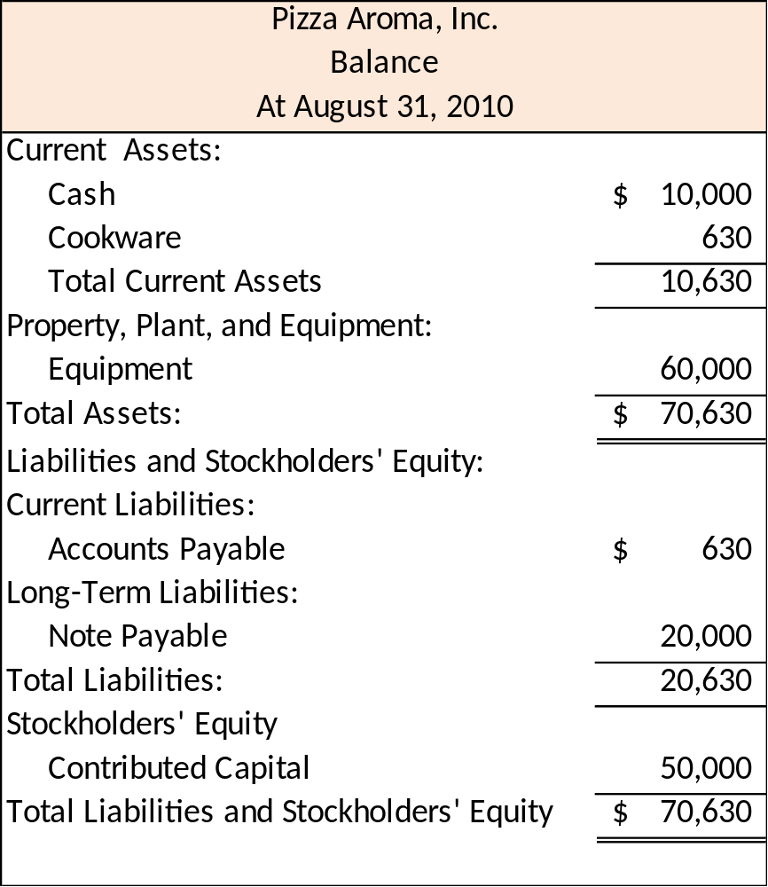
Classified Balance Sheet
Current assets will be used up or converted into cash within the next 12 months.
Long-term assets include resources that will be used or turned into cash more than 12 months after the balance sheet date.
2-<number>
Notes:
A classified balance sheet contains subcategories for assets and liabilities labeled current. Current assets are assets the business will use up or turn into cash within 12 months of the balance sheet date. Current liabilities are debts and other obligations that will be paid or fulfilled within 12 months of the balance sheet date. Equipment and Note Payable accounts, and stockholders’ equity accounts are understood to be long-term in nature. Retained Earnings account in stockholders’ equity despite its zero balance because we don’t want you to forget about this account.

Slide 2
Chapter 3
Reporting Operating Results on the Income Statement
Notes:
Chapter 3: Business Decision and Financial Accounting

Slide 3
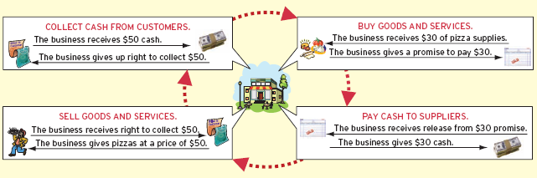
Operating Activities
3-<number>
Notes:
Part I
Operating activities are the day-to-day functions involved in running a business. Unlike the investing and financing activities in Chapter 2 that occur infrequently and typically produce long-lasting effects, operating activities occur regularly and often have a shorter duration of effect. Operating activities include buying goods and services from suppliers and employees and selling goods and services to customers and then collecting cash from them.
Part II
The period from buying goods and services through to collecting cash from customers is known as the operating cycle. This graphic illustrates the operating cycle for Pizza Aroma. Although most businesses have the same steps in their operating cycles, the length of time for each step varies from company to company. For example, Pizza Aroma usually collects cash from restaurant customers within minutes of making a sale, whereas a company like Kellogg’s might wait several weeks to collect on sales it makes to grocery stores. Operating activities are the primary source of revenues and expenses and, thus, can determine whether a company earns a profit (or incurs a loss).

Slide 4
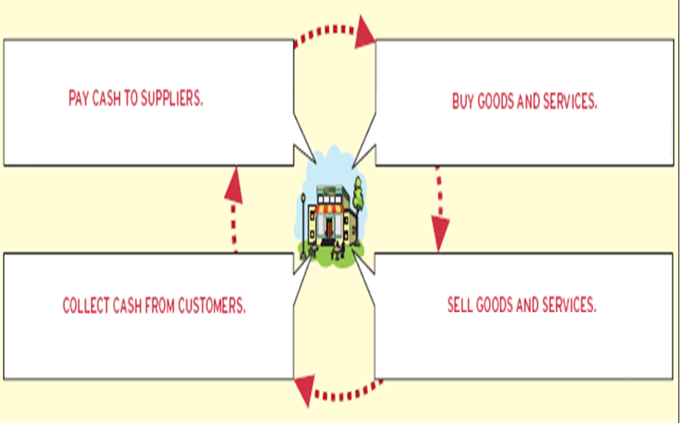
Operating Activities
3-<number>
Notes:
Part I
Operating activities are the day-to-day functions involved in running a business. Unlike the investing and financing activities in Chapter 2 that occur infrequently and typically produce long-lasting effects, operating activities occur regularly and often have a shorter duration of effect. Operating activities include buying goods and services from suppliers and employees and selling goods and services to customers and then collecting cash from them.
Part II
The period from buying goods and services through to collecting cash from customers is known as the operating cycle. This graphic illustrates the operating cycle for Pizza Aroma. Although most businesses have the same steps in their operating cycles, the length of time for each step varies from company to company. For example, Pizza Aroma usually collects cash from restaurant customers within minutes of making a sale, whereas a company like Kellogg’s might wait several weeks to collect on sales it makes to grocery stores. Operating activities are the primary source of revenues and expenses and, thus, can determine whether a company earns a profit (or incurs a loss).

Slide 5

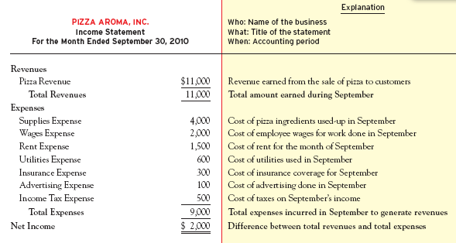
Income Statement Accounts
3-<number>
Notes:
Part I
Although a manager or owner may intuitively sense how the business is doing, a more reliable management approach is to evaluate the revenues and expenses reported on the income statement. This slide illustrates the income statement based on the operating activities that were expected for Pizza Aroma as discussed in Chapter 1. This projected income statement will provide a benchmark to evaluate Pizza Aroma’s actual results.
Part II
Revenues are the amounts a business charges its customers for goods or services. If Pizza Aroma sells 1,100 pizzas in September and charges $10 per pizza, Pizza Revenue would total $11,000. The amount of revenues earned during the period is the first thing reported in the body of the income statement.
Part III
Expenses are any costs of operating the business, incurred to generate revenues in the period covered by the income statement. Anything a business uses up to generate revenues during the period is an expense, regardless of when it was or will be paid for. Expenses are reported in the body of the income statement after revenues.
Part IV
Net income is a total that is calculated by subtracting expenses from revenues; it is not an account like Pizza Revenue or Wages Expense. This total summarizes the overall impact of revenues and expenses in a single number. It is called a net loss if expenses are greater than revenues, and net income if revenues are greater than expenses. Net income indicates the amount by which stockholders’ equity increases as a result of a company’s profitable operations. For this reason, net income (or loss) is a closely watched measure of a company’s success.

Slide 6

Cash Basis Accounting
Cash basis accounting records revenues when cash is received and expenses when cash is paid.
3-<number>
Notes:
Like most people, you probably look at the balance in your bank account to gauge your financial performance. If the overall balance increased this month, you likely take that as a sign that you’ve done a good job of managing your finances. If it has gone down, that is a clue that you need to tame yourself a little more next month.
Because the cash inflows and outflows occur close in time to the activities that cause those cash flows, using your bank balance tends to give a decent measure of financial performance. This is a cash basis of accounting. The cash basis of accounting records revenues when cash is received and expenses when cash is paid.
However, the cash basis of accounting doesn’t measure financial performance very well when transactions are conducted using credit rather than cash. The problem is that credit often introduces a significant delay between the time an activity occurs and the time it impacts the bank account balance. So, what accounting method is preferred?

Slide 7
Accrual Basis Accounting
GAAP
Accrual Basis Accounting
Records revenues when they are earned and expenses when they are incurred, regardless of the timing of cash receipts or payments.
3-<number>
Notes:
Generally accepted accounting principles require the use of the accrual basis of accounting. The cash basis can be used internally by some small companies, but GAAP do not allow it to be used for external reporting. The “rule of accrual” is that the financial effects of business activities are measured and reported when the activities actually occur, not when the cash related to them is received or paid. That is, revenues are recognized when they are earned and expenses when they are incurred. The two basic accounting principles that determine when revenues and expenses are recognized under accrual basis accounting are called the revenue principle and the matching principle.

Slide 8
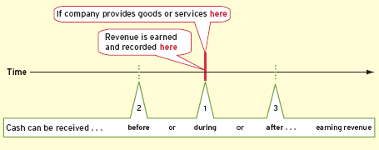
Revenue Principle—Revenue Recognition
Timing of Reporting Revenue versus Cash Receipts
1
Cash is received in the same period as the goods or services are provided.
Revenue Principle
Revenues are recognized when they are earned.
2
Cash is received in a period before goods or services are provided.
3
Cash is received in a period after goods or services are provided.
3-<number>
Notes:
Part I
All companies expect to receive cash in exchange for providing goods and services, but the timing of cash receipts does not dictate when revenues are recognized. Instead, the key factor in determining when to recognize revenue is whether the company has done what it promised during the accounting period. Regardless of the length of the
period (month, quarter, or year), cash can be received (1) in the same period as the goods or services are provided, (2) in a period before the goods or services are provided, or (3) in a period after the goods or services are provided, as shown on the timeline on this slide.
Part II
Receiving cash in the same period as the promised acts are performed is a common occurrence for Pizza Aroma because customers pay within a few minutes of receiving their pizza. Pizza Aroma delivers the pizza to the customer as ordered, earning revenue in the process. In exchange, Pizza Aroma receives cash from the customer.
Part III
Receiving cash in a period before the promised acts are performed can occur when Pizza Aroma receives cash for gift cards that customers can use to pay for pizza in the future. Pizza Aroma will record the cash received, but since it hasn’t delivered pizza for these customers, no revenue is recorded yet. Instead, Pizza Aroma has an obligation to accept the gift card as payment for pizza in the future. This obligation is a liability called Unearned Revenue.
Part IV
Receiving cash in a period after the promised acts are performed typically arises when a company sells to a customer on account. Selling on account means that the company provides goods or services to a customer not for cash, but instead for the right to collect cash in the future. This right is an asset called Accounts Receivable. Thus, if Pizza Aroma delivers pizza sold on account to a college organization in September, it will report Pizza Revenue on the income statement and Accounts Receivable on the balance sheet in September.

Slide 9
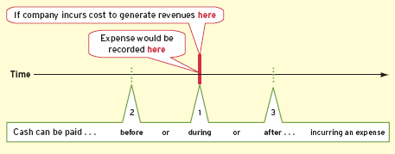
Matching Principle—Expense Recognition
Timing of Reporting Expenses versus Cash Payments
1
Cash is paid at the same time as the cost is incurred to generate revenue.
Matching Principle
Record expenses in the same period as the revenues with which they can be reasonably associated.
2
Cash is paid before the expense is incurred to generate revenue.
3
Cash is paid after the cost is incurred to generate revenue.
3-<number>
Notes:
Part I
The business activities that generate revenues also create expenses. Under accrual basis accounting, expenses are recognized in the same period as the revenues to which they relate, not necessarily the period in which cash is paid for them. This is what accountants call the matching principle: record expenses in the same period as the revenues with which they can be reasonably associated. It is the timing of the underlying business activities, not the cash payments, that dictates when expenses are recognized. Cash payments may occur (1) at the same time as, (2) before, or (3) after the related expenses are incurred to generate revenue, as shown on this graphic.
Part II
Expenses are sometimes paid for in the period that they arise. For example, Pizza Aroma could spend $50 cash for balloons to celebrate its grand opening this month. It would report this cost on this month’s income statement because the balloons were used for an activity occurring this month. In other words, the benefits of incurring the cost are entirely used up within the current accounting period.
Part III
It is common for businesses to pay for something that provides benefits only in future periods. For example, Pizza Aroma might buy paper napkins now but does not use them until next month. The asset Supplies is increased and Cash is decreased. Given the matching principle, the expense from using these supplies is reported next month when the supplies are used to earn revenue, not now when purchased.
Part IV
Many costs are paid after receiving and using goods or services. For example, Pizza Aroma uses electricity to heat the ovens and light the restaurant this month but does not pay for its electricity usage until next month. Because the cost of the electricity relates to revenues earned now, it represents an expense that will be reported on this month’s income statement. Because the cost has not yet been paid at the end of the month, a liability called Accounts Payable is created. Similar situations arise when employees work in the current period but are not paid their wages until the following period.

Slide 10
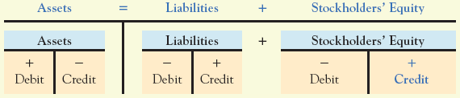

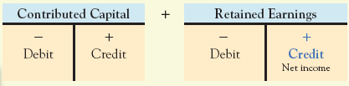
The Expanded Accounting Equation
Exhibit 3.7
-
Revenues are recorded with credits.
Expenses are recorded with debits.
Revenues
Expenses
3-<number>
Notes:
Part I
Remember the basic accounting equation from Chapter 2? That is, assets equals liabilities plus stockholders’ equity, or A = L + SE.
Part II
Remember that asset accounts increase on the left or debit side and decrease on the right or credit side. Liability accounts increase on the right or credit side and decrease on the left or debit side. This is just opposite of the way assets increase and decrease. And, like liability accounts, stockholders’ equity accounts also increase on the right or credit side and decrease on the left or debit side.
Part III
Stockholders’ equity represents the stockholders’ investment in the company, which comes from either (1) contributed capital, given to the company by stockholders in exchange for stock or (2) retained earnings, generated by the company itself through profitable operations.
Part IV
Retained earnings is the part that expands to include revenues and expenses. Remember that revenue minus expenses equals net income (or net loss).
Part V
Think of revenues and expenses as subcategories within retained earnings, which is part of stockholders’ equity. Because revenue and expense accounts are subcategories of retained earnings, they are affected by debits and credits in the same way as all stockholders’ equity accounts. You already know that increases in stockholders’ equity are recorded on the right side. You also know that revenues increase net income, which increases the stockholders’ equity account called Retained Earnings. So putting these ideas together should lead to the conclusion that revenues are recorded on the right (credit). Decreases in stockholders’ equity are recorded on the left side, so to show that expenses decrease net income and retained earnings, expenses are recorded on the left (debit).

Slide 11


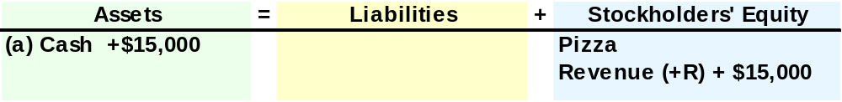

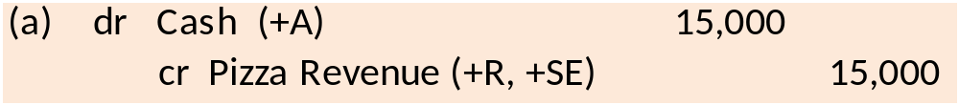


Pizza Aroma’s Accounting Records
(a) Provided services for cash.
In September, Pizza Aroma delivered pizza to customers for $15,000 cash.
1
Analyze
2
Record
3
Summarize
3-<number>
Notes:
Part I
In September, Pizza Aroma delivered pizza to customers for $15,000 cash.
Part II
Analyze the transaction. In this case Cash, an asset, increased by $15,000, and Pizza Revenue, a subcategory of Stockholders’ Equity, increased by the same amount.
Part III
The general journal entry is to debit, or increase, the asset Cash for $15,000, and credit, or increase, Pizza Revenue for the same amount.
Part IV
We summarize the transaction by posting the amount to the general ledger accounts. The Cash account will increase by $15,000, and the Pizza Revenue account will also increase by $15,000.

Slide 12
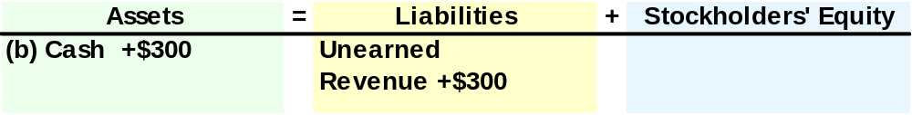
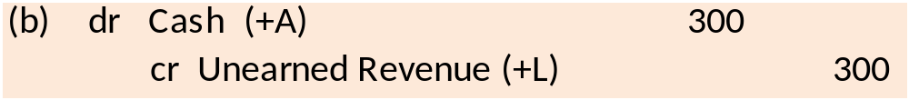


Pizza Aroma’s Accounting Records
(b) Receive cash for future services.
Pizza Aroma sold three $100 gift cards at the beginning of September.
1
Analyze
2
Record
3
Summarize
3-<number>
Notes:
Part I
Pizza Aroma sold three $100 gift cards at the beginning of September.
Part II
Analyze the transaction. In this case Cash, an asset, increased by $300, and Unearned Revenue, a liability, increased by the same amount.
Part III
The general journal entry is to debit, or increase, the asset Cash for $300, and credit, or increase, Unearned Revenue, a liability, for the same amount.
Part IV
We summarize the transaction by posting the amount to the general ledger accounts. The Cash accounting will increase by $300, and the Unearned Revenue account will also increase by the same amount.

Slide 13
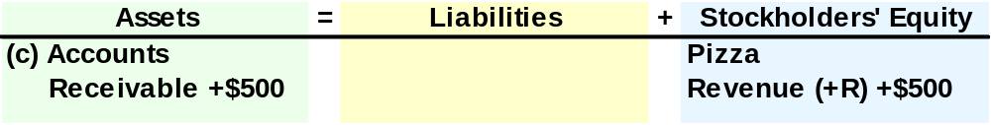
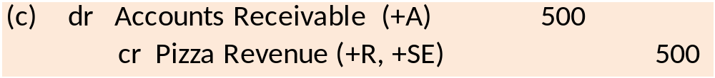

Pizza Aroma’s Accounting Records
(c) Provide services on credit.
Pizza Aroma delivers $500 of pizza to a college organization, billing this customer on account.
1
Analyze
2
Record
3
Summarize
3-<number>
Notes:
Part I
Pizza Aroma delivers $500 of pizza to a college organization, billing this customer on account.
Part II
Analyze the transaction. In this case Accounts Receivable, an asset, increased by $500, and Pizza Revenue, a subcategory of stockholders’ equity, increased by the same amount.
Part III
The general journal entry is to debit, or increase, the asset Accounts Receivable for $500, and credit, or increase, Pizza Revenue for the same amount.
Part IV
We summarize the transaction by posting the amount to the general ledger accounts. The Accounts Receivable account will increase by $500, and the Pizza Revenue account will increase by the same amount.

Slide 14
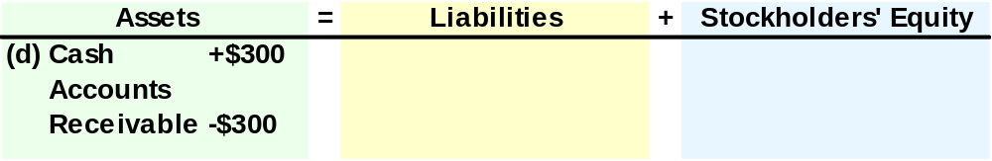
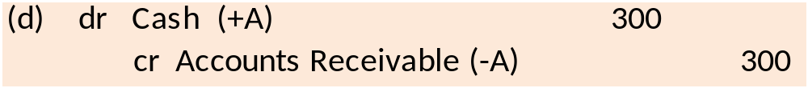

Pizza Aroma’s Accounting Records
(d) Receive payment on account.
Pizza Aroma received a $300 check from the college organization, as partial payment of its account balance.
1
Analyze
2
Record
3
Summarize
3-<number>
Notes:
Part I
Pizza Aroma received a $300 check from the college organization, as partial payment of its account balance.
Part II
Analyze the transaction. In this case Cash, an asset, increased by $300, and Accounts Receivable, an asset, decreased by the same amount.
Part III
The general journal entry is to debit, or increase, the asset Cash for $300, and credit, or decrease, Accounts Receivable, an asset, for the same amount.
Part IV
We summarize the transaction by posting the amount to the general ledger accounts. The Cash accounting will increase by $300, and the Accounts Receivable account will decrease by the same amount.

Slide 15

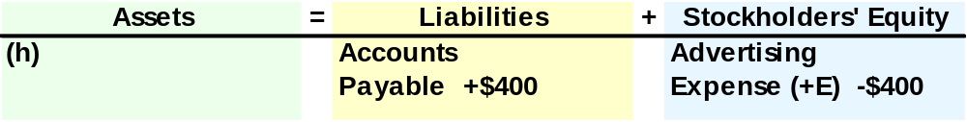
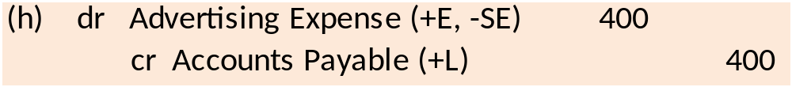

Pizza Aroma’s Accounting Records
(h) Incur cost to be paid later.
Pizza Aroma received a bill for $400 for running a newspaper ad in September. The bill will be paid in October.
1
Analyze
2
Record
3
Summarize
3-<number>
Notes:
Part I
Pizza Aroma received a bill for $400 for running a newspaper ad in September. The bill will be paid in October.
Part II
Analyze the transaction. In this case Accounts Payable, a liability, increased by $400, and Advertising Expense, a subcategory of stockholders’ equity, increased by $400, which causes stockholders’ equity to decrease.
Part III
The general journal entry is to debit, or increase, Advertising Expense for $400, and credit, or increase, Accounts Payable, a liability, for the same amount.
Part IV
We summarize the transaction by posting the amount to the general ledger accounts. The Accounts Payable account will increase by $400, and the Advertising Expense account will increase by the same amount.

Slide 16
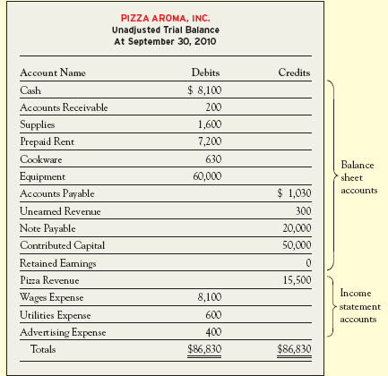
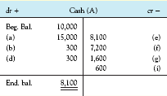
Unadjusted Trial Balance
Cash Ledger Account
3-<number>
Notes:
Part I
After summarizing journal entries in the various accounts and then calculating ending balances for each account, you should check that the total recorded debits equal the total recorded credits. The best way to ensure your accounts are “in balance” is to prepare a trial balance , like the one on this slide. Typically, a trial balance lists every account name in one column (usually in the order of assets, liabilities, stockholders’ equity; revenues, and then expenses).
Part II
The ending balances obtained from the ledgers (T-accounts) are listed in the appropriate debit or credit column. For example, on the Unadjusted Trial Balance, the Cash listing for $8,100 comes from the balance in the Cash ledger account.

Slide 17
Review of Revenues and Expenses
(1) Cash is received before the company earns revenue.
(3) Cash is received after the company earns revenue.
dr. Cash
cr. Unearned Rev.
dr. Cash
cr. Accounts Rec.
Earn Revenue
Earn Revenue
$
dr. Unearned Rev.
cr. Revenue
dr. Accounts Rec.
cr. Revenue
$
(2) Cash is received in the same period the company earns revenue.
$
Earn Revenue
dr. Cash
cr. Revenue
3-<number>
Notes:
Part I
Remember that revenues are recorded when the business fulfills its promise to provide goods or services to customers, which is not necessarily the same time that cash is received. Here is a summary of the three cases we discussed earlier.
First, cash is received before revenue is earned by delivering goods or services. The journal entry to record the cash receipt is a debit to Cash and a credit to Unearned Revenue. Later when the services or goods are delivered, the journal entry is a debit to Unearned Revenue and a credit to Service Revenue.
Part II
Second, cash is received at the same time as revenue is earned by delivering goods or services. The journal entry to record this transaction is a debit to Cash and a credit to Service Revenue.
Part III
Third, cash is received after revenue is earned by delivering goods or services. The journal entry to record the delivery of the goods or services is a debit to Accounts Receivable and a credit to Service Revenue. Later when the cash is collected, the journal entry is a debit to Cash and a credit to Accounts Receivable.

Slide 18
Review of Revenues and Expenses
(1) Cash is paid before the expense is incurred.
(3) Cash is paid after the expense is incurred.
dr. Prepaid Expense
cr. Cash
dr. Accounts Payable
cr. Cash
Use-up Benefits
Use-up Benefits
$
dr. Business Expense
cr. Prepaid Expense
dr. Business Expense
cr. Accounts Payable
$
(2) Cash is paid in the same period the expense is incurred.
$
Use-up Benefits
dr. Business Expense
cr. Cash
3-<number>
Notes:
Part I
Remember that expenses are recorded when they are incurred, which is not necessarily the same time that cash is paid.
Here is a summary of the three cases we discussed earlier.
First, cash is paid before the expense is incurred. The journal entry to record the cash payment is a debit to Prepaid Expense and a credit to Cash. Later when the expense is incurred, the journal entry is a debit to the appropriate Expense account and a credit to Prepaid Expense. Prepaid Expenses are assets such as Prepaid Rent and Prepaid Insurance.
Part II
Second, cash is paid at the same time the expense is incurred. The journal entry to record this transaction is a debit to the Expense account and a credit to Cash.
Part III
Third, cash is paid after the expense is incurred. The journal entry to record the incurrence of the expense is a debit to the Expense account and a credit to Accounts Payable. Later when the cash is paid, the journal entry is a debit to Accounts Payable and a credit to Cash.

Slide 19
Income Statement Limitations
NI ≠ Cash
NI ≠ Δ Value
NI ≠ Exact
3-<number>
Notes:
One of the most common misconceptions is that some people think that net income equals the amount of cash generated by the business during the period. Following the rules of accrual accounting, revenues are recorded when earned and expenses are recorded when incurred, regardless of when cash is received or paid.
A second limitation is that net income does not measure the change in the value of a company during a period. Many other factors can cause the value of a company to change without affecting net income. A good example is the increase in the value of Pizza Aroma’s name as its reputation for making great pizza grows. So, net income measures many of the most important events that affect a business’s value, but it does not include all events that potentially affect a company’s value.
A third common misconception is that measuring net income just involves counting. Estimation also plays a key role when measuring income. We will learn more about this in chapter 4. For now, just note that net income is not always a precise measure.

Slide 20
Chapter 3
Solved Exercises
M3-2, M3-3, M3-4, M3-5, M3-13, M3-14
Notes:
Chapter 3 Solved Exercises: M3-3, M3-4, M3-5, M3-13, M3-14

Slide 21

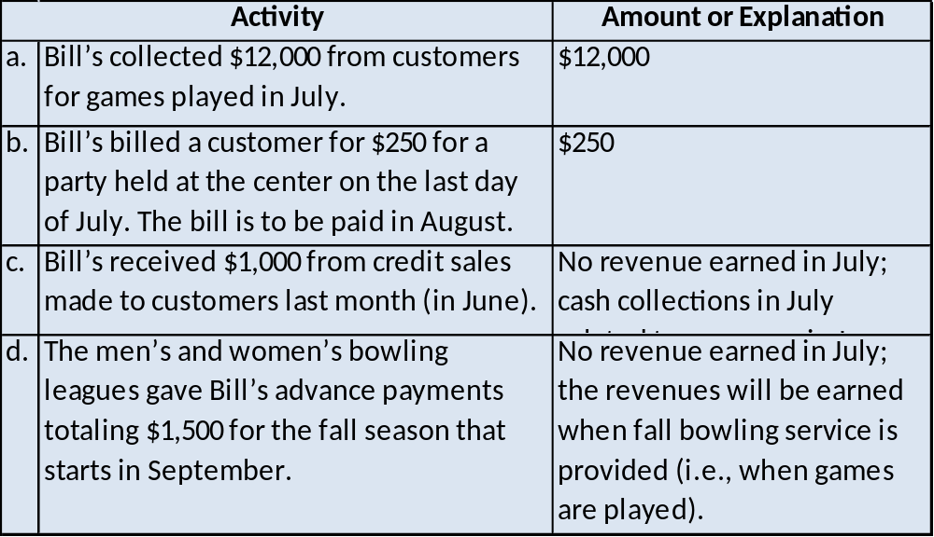
M3-2 Identifying Revenues
The following transactions are July 2010 activities of Bill’s Extreme Bowling Inc., which operates several bowling centers. If revenue is to be recognized in July, indicate the amount. If revenue is not to be recognized in July, explain why.
3-<number>
Notes:
Part I
M3-2 Identifying Revenues
The following transactions are July 2010 activities of Bill’s Extreme Bowling Inc., which operates several bowling centers. If revenue is to be recognized in July, indicate the amount. If revenue is not to be recognized in July, explain why.
Part II
Bill’s collected $12,000 from customers for games played in July. The amount of revenue recognized in July is $12,000.
Part III
Bill’s billed a customer for $250 for a party held at the center on the last day of July. The bill is to be paid in August. The amount of revenue recognized in July is $250.
Part IV
Bill’s received $1,000 from credit sales made to customers last month (in June). No revenue is earned in July. The cash collections in July related to revenues earned in June.
Part V
The men’s and women’s bowling leagues gave Bill’s advance payments totaling $1,500 for the fall season that starts in September. No revenue is earned in July. The revenues will be earned when fall bowling service is provided (i.e., when the games are played).

Slide 22
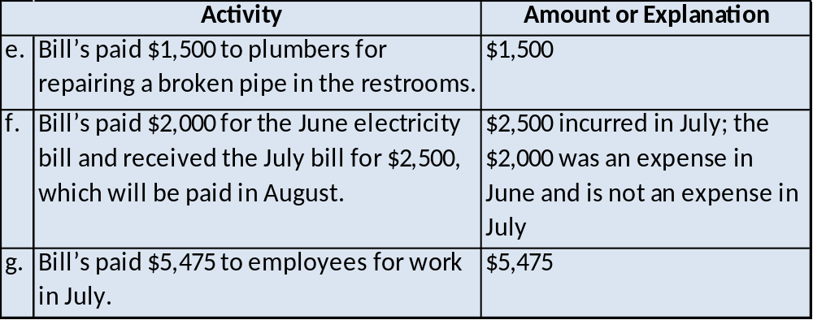
M3-3 Identifying Expenses
The following transactions are July 2010 activities of Bill’s Extreme Bowling, Inc., which operates several bowling centers. If an expense is to be recognized in July, indicate the amount. If an expense is not to be recognized in July, explain why.
3-<number>
Notes:
Part I
M3-3 Identifying Expenses
The following transactions are July 2010 activities of Bill’s Extreme Bowling, Inc., which operates several bowling centers. If an expense is to be recognized in July, indicate the amount. If an expense is not to be recognized in July, explain why.
Part II
Bill’s paid $1,500 to plumbers for repairing a broken pipe in the restrooms. The amount of July expense is $1,500.
Part III
Bill’s paid $2,000 for the June electricity bill and received the July bill for $2,500, which will be paid in August. Two thousand five hundred dollars was incurred as an expense in July. The $2,000 was an expense in June and is not an expense in July.
Part IV
Bill’s paid $5,475 to employees for work in July. The amount of July expense is $5,475.

Slide 23

M3-4 Recording Revenues
For each of the transactions in M3-2, write the journal entry using the format shown in the chapter.
dr Cash (+A) 12,000
cr Games Fee Revenue (+R, +SE) 12,000
dr Accounts Receivable (+A) 250
cr Service Revenue (+R, +SE) 250
dr Cash (+A) 1,000
cr Accounts Receivable (−A) 1,000
dr Cash (+A) 1,500
cr Unearned Revenue (+L) 1,500
3-<number>
Notes:
Part I
M3-4 Recording Revenues
For each of the transactions in M3-2, write the journal entry using the format shown in the chapter.
Part II
Debit Cash and credit Games Fee Revenue for $12,000.
Part III
Debit Accounts Receivable and credit Service Revenue for $250.
Part IV
Debit Cash and credit Accounts Receivable for $1,000.
Part V
Debit Cash and credit Unearned Revenue for $1,500.

Slide 24
M3-5 Recording Expenses
For each of the transactions in M3-3, write the journal entry using the format shown in the chapter.
dr Repairs and Maintenance Expense (+E, −SE) 1,500
cr Cash (−A) 1,500
dr Accounts Payable (–L) 2,000
cr Cash (−A) 2,000
dr Utilities Expense (+E, −SE) 2,500
cr Accounts Payable (+L) 2,500
dr Wages Expense (+E, −SE) 5,475
cr Cash (−A) 5,475
3-<number>
Notes:
Part I
M3-5 Recording Expenses
For each of the transactions in M3-3, write the journal entry using the format shown in the chapter.
Part II
Debit Repairs and Maintenance Expense and credit Cash for $1,500.
Part III
Debit Accounts Payable and credit Cash for $2,000.
Part IV
Debit Utilities Expense and credit Accounts Payable for $2,500.
Part V
Debit Wages Expense and credit Cash for $5,475.

Slide 25

M3-13 Preparing Journal Entries for Business Activities
Quick Cleaners, Inc. (QCI) has been in business for several years. It specializes in cleaning houses but has some small business clients as well. Prepare journal entries for the following transactions, which occurred during a recent month:
Incurred $600 of heating and electrical costs this month and will pay them next month.
Issued $25,000 of QCI stock for cash.
dr Utilities (or Heating/Electrical) Expense (+E -SE) 600
cr Accounts (or Utilities) Payable (+L) 600
dr Cash (+A) 25,000
cr Contributed Capital (+SE) 25,000
(or Capital/Common Stock)
3-<number>
Notes:
Part I
M3-13 Preparing Journal Entries for Business Activities
Quick Cleaners, Inc. (QCI) has been in business for several years. It specializes in cleaning houses but has some small business clients as well. Prepare journal entries for the following transactions, which occurred during a recent month:
Incurred $600 of heating and electrical costs this month and will pay them next month.
Part II
Debit Utilities (or Heating/Electrical) Expense and credit Accounts (or Utilities) Payable for $600.
Issued $25,000 of QCI stock for cash.
Part III
Debit Cash and credit Contributed Capital (or Capital/Commons Stock) for $25,000.

Slide 26

M3-13 Preparing Journal Entries for Business Activities
Paid wages for the current month, totaling $2,000.
Performed cleaning services on account worth $2,800.
Some of Quick Cleaners’ equipment was repaired at a total cost of $150. The company paid the full amount immediately.
c. dr Wages Expense (+E -SE) 2,000
cr Cash (-A) 2,000
d. dr Accounts Receivable (+A) 2,800
cr Services/Cleaning Revenue (+R +SE) 2,800
dr Repairs and Maintenance Expense (+E -SE) 150
cr Cash (-A) 150
3-<number>
Notes:
Part I
Paid wages for the current month, totaling $2,000.
Part II
Debit Wages Expense and credit Cash for $2,000.
Performed cleaning services on account worth $2,800.
Part III
Debit Accounts Receivable and credit Services/Cleaning Revenue for $2,800.
Some of Quick Cleaners’ equipment was repaired at a total cost of $150. The company paid the full amount immediately.
Part IV
Debit Repairs and Maintenance Expense and credit Cash for $150.

Slide 27

M3-14 Preparing Journal Entries for Business Activities
Junktrader is an online company that specializes in matching buyers and sellers of used items. Buyers and sellers can purchase a membership with Junktrader, which provides them advance notice of potentially attractive offers. Prepare journal entries for the following transactions, which occurred during a recent month.
Junktrader provided online advertising services for another company for $200 on account.
On the last day of the month, Junktrader paid $50 cash to run an ad promoting the company’s services. The ad ran that day in the local newspaper.
dr Accounts Receivable (+A) 200
cr Advertising (or Service) Revenue (+R +SE) 200
dr Advertising Expense (+E -SE) 50
cr Cash (-A) 50
3-<number>
Notes:
Part I
M3-14 Preparing Journal Entries for Business Activities
Junktrader is an online company that specializes in matching buyers and sellers of used items. Buyers and sellers can purchase a membership with Junktrader, which provides them advance notice of potentially attractive offers. Prepare journal entries for the following transactions, which occurred during a recent month.
Junktrader provided online advertising services for another company for $200 on account.
Part II
Debit Accounts Receivable and credit Advertising (or Service) Revenue for $200.
On the last day of the month, Junktrader paid $50 cash to run an ad promoting the company’s services. The ad ran that day in the local newspaper.
Part III
Debit Advertising Expense and credit Cash for $50.

Slide 28

M3-14 Preparing Journal Entries for Business Activities
Received $200 cash in membership fees for the month from new members.
Received an electricity bill for $85, for usage this month. The bill will be paid next month.
Billed a customer $180 for helping them sell their junk. The customer is expected to pay by the end of next month.
dr Cash (+A) 200
cr Membership (or Fees) Revenue (+R +SE) 200
d. dr Utilities (or Electricity) Expense (+E -SE) 85
cr Accounts (or Utilities) Payable (+L) 85
dr Accounts Receivable (+A) 180
cr Services (or Sales) Revenue (+R +SE) 180
3-<number>
Notes:
Part I
Received $200 cash in membership fees for the month from new members.
Part II
Debit Cash and credit Membership (or Fees) Revenue for $200.
Received an electricity bill for $85, for usage this month. The bill will be paid next month.
Part III
Debit Utilities (or Electricity) Expense and credit Accounts (or Utilities) Payable for $85.
Billed a customer $180 for helping them sell their junk. The customer is expected to pay by the end of next month.
Part IV
Debit Accounts Receivable and credit Services (or Sales) Revenue for $180.

